Slide 1
Gauss’s Law

Slide 2
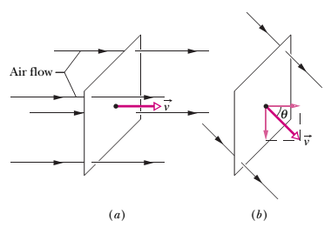
Flux
The word “flux” comes from the Latin word meaning “to flow.”
Let  represent the volume flow rate (volume per unit time) at which air flows through the loop. This rate depends on the angle between v and the plane of the loop. If v is perpendicular to the plane, the rate " is equal to vA.

Slide 3

Flux
If is parallel to the plane of the loop, no air moves through the loop, so  is zero. For an intermediate angle the rate  depends on the component of v normal to the plane. Since that component is v cosθ, the rate of volume flow through the loop is
This rate of flow through an area is an example of a flux—a volume flux in this situation.

Slide 4
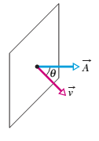

an area vector as being a vector whose magnitude is equal to an area (here the area of the loop) and whose direction is normal to the plane of the area

Slide 5
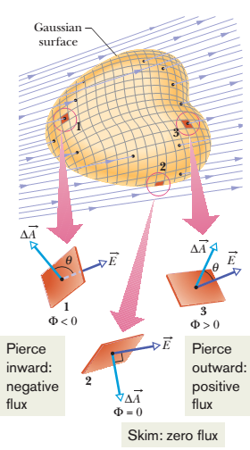
Flux of an Electric Field
To define the flux of an electric field, consider an arbitrary (asymmetric) Gaussian surface immersed in a non uniform electric field.
Let us divide the surface into small squares of area A, each square being small enough to permit us to neglect any curvature and to consider the individual square to be flat.

Slide 6
Flux of an Electric Field
We represent each such element of area with an area vector , whose magnitude is the area ∆A.
Each vector is perpendicular to the Gaussian surface and directed away from the interior of the surface.
Because the squares have been taken to be arbitrarily small, the electric field may be taken as constant over any given square. The vectors and for each square then make some angle θ with each other.

Slide 7

Flux of an Electric Field
Figure shows an enlarged view of three squares on the Gaussian surface and the angle θ for each.
A provisional definition for the flux of the electric field for the Gaussian surface

Slide 8
This equation instructs us to visit each square on the Gaussian surface, evaluate the scalar product for the two vectors and we find there, and sum the results algebraically (that is, with signs included) for all the squares that make up the surface.
The value of each scalar product (positive, negative, or zero) determines whether the flux through its square is positive, negative, or zero.
Squares like square1 in which points inward, make a negative contribution to the sum.
Squares like 2, in which lies in the surface, make zero contribution.
Squares like 3, in which points outward, make a positive contribution.

Slide 9

Flux of an Electric Field
The exact definition of the flux of the electric field through a closed surface is
The loop on the integral sign indicates that the integration is to be taken over the entire (closed) surface.
The flux of the electric field is a scalar, and its SI unit is the newton–square-meter per coulomb (N' m2/C)

Slide 10
We can interpret last eq in the following way:
First recall that we can use the density of electric field lines passing through an area as a proportional measure of the magnitude of the electric field there.
Specifically, the magnitude E is proportional to the number of electric field lines per unit area.
Thus, the scalar product in Eq is proportional to the number of electric field lines passing through area.
Then, because the integration in Eq. is carried out over a Gaussian surface, which is closed, so
The electric flux " through a Gaussian surface is proportional to the net number of electric field lines passing through that surface

Slide 11
Problem
A Gaussian surface in the form of a cylinder of radius R immersed in a uniform electric field , with the cylinder axis parallel to the field. What is the flux of the electric field through this closed surface?

Slide 12

Solution
We can find the flux through the Gaussian surface by integrating the scalar product over that surface.
We can do the integration by writing the flux as the sum of three terms: integrals over the left cylinder cap a,the cylindrical surface b, and the right cap c.

Slide 13



Slide 14

